Slide 1
Draw the Indian Flag
Lab Activity 6

Slide 2
Objectives
By the end of this activity, students will be able to:
Remembering – Recall steps to open MS Paint.
Understanding – Explain parts and colors of the flag.
Applying – Use tools to draw and color the flag.
Analysing – Identify shapes used in the flag.
Evaluating – Check if the flag is neat and correct.
Creating – Create a digital Indian flag drawing.

Slide 3
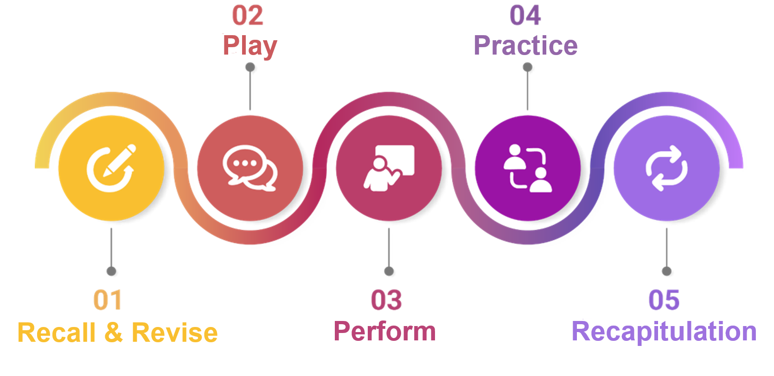

Slide 4


Slide 5

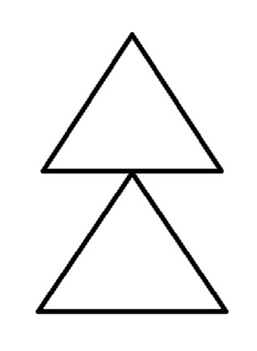
Recall & Revise
Tinku’s Christmas Tree
Tinku opens MS Paint and draws a festive Christmas Tree using triangles and a rectangle.
He fills the tree with green and brown colors and adds shiny decorations.
After saving it as ‘Tree’, he smiles and shuts down the computer.
1. Identify the name of the shape used to draw the Christmas tree leaves.
a) Triangle
b) Circle

Slide 6
Recall & Revise
Tinku’s Christmas Tree
2. What tool did Tinku use to draw the Stem of the Christmas Tree?
a) Triangle tool
b) Rectangle tool
3. To save the file, Tinku click on the _________ option, then save and save the files.

Slide 7
Recall & Revise
Tinku’s Christmas Tree
a) Triangle
b) Rectangle tool
File

Slide 8


Slide 9

Discuss
Tinku’s Independence Day Tribute
It was a special day at Tinku’s school. Everyone was preparing to celebrate Independence Day with lots of excitement and pride. The school had organized a drawing competition, and the top three winners would receive special prizes!

Slide 10
Discuss
Tinku’s Independence Day Tribute
Tinku thought for a moment and said,
“I want to create something meaningful. I’ll draw the Indian flag using MS Paint and gift it to my friend too!”

Slide 11

Discuss
Tinku’s Independence Day Tribute
He turned on the computer and smiled.
“Will you help me make it perfect? Let’s work on it together!”

Slide 12


Slide 13
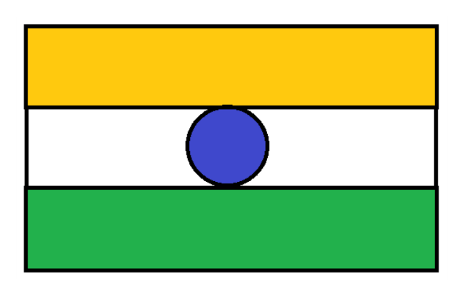
In this activity, you will draw the Indian Flag in MS Paint.

Slide 14


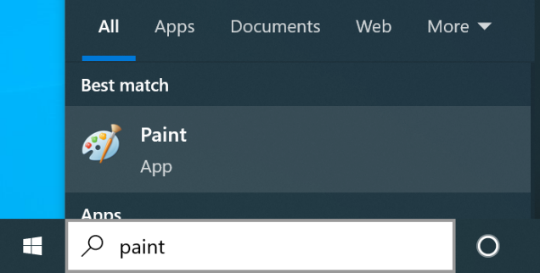
Discuss
“Let’s open MS Paint,” he said.
First, click on the Search bar on the screen.
Type ‘paint’.
Click on the Paint icon that pops up.

Slide 15
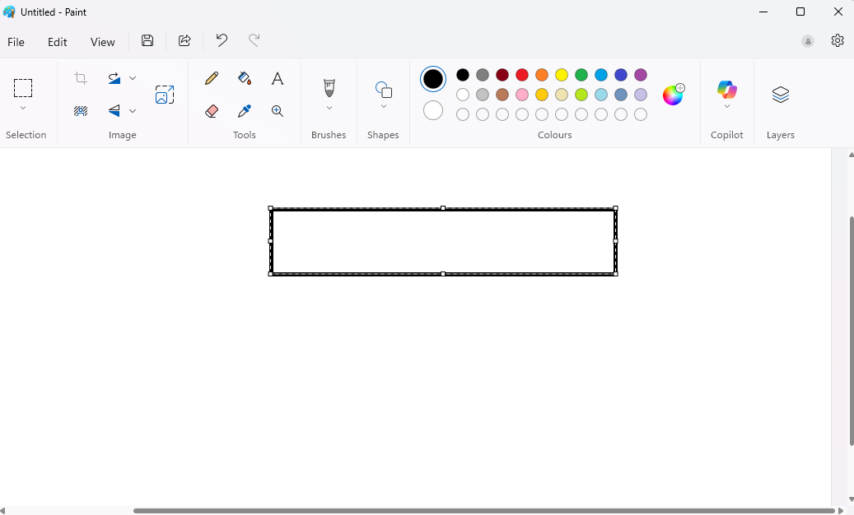
Draw the Indian Flag
Select the Rectangle tool. Draw three rectangles of similar size like this.

Slide 16
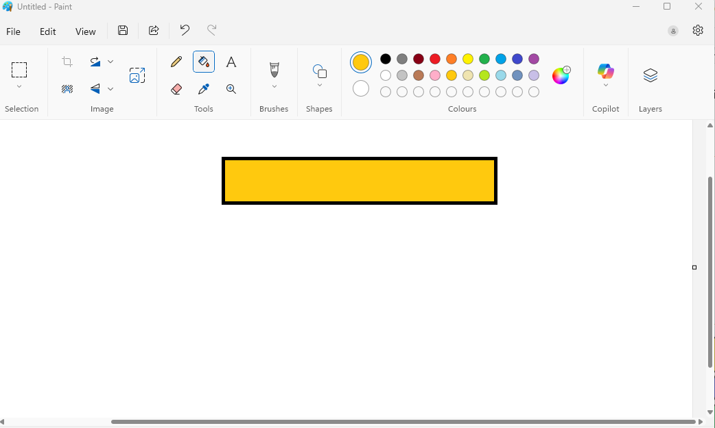
Draw the Indian Flag
Select the Fill tool. Use the Orange colour to colour the rectangle.

Slide 17
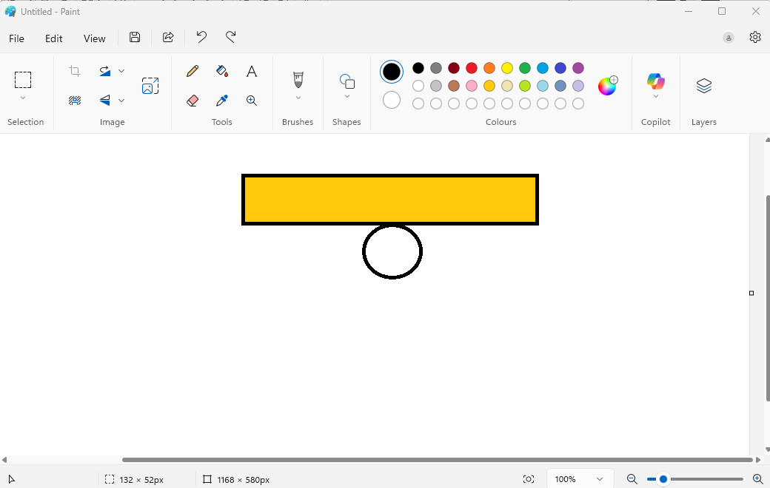
Draw the Indian Flag
Select the Circle tool. Draw a circle in the centre showing Ashok Chakra

Slide 18


Slide 19
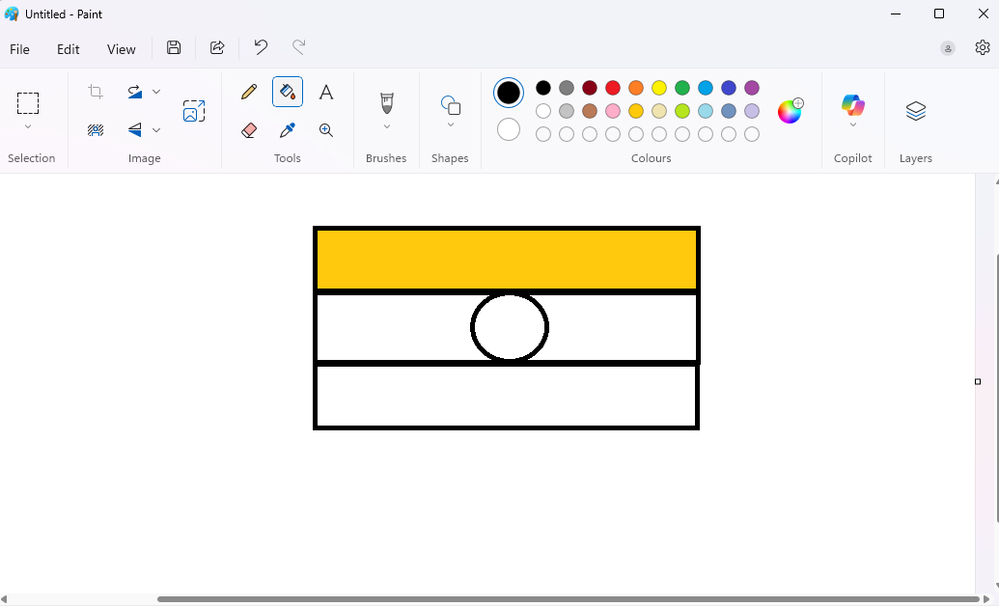
Draw the Indian Flag
Select the Rectangle tool. Draw three rectangles of similar size like this.

Slide 20
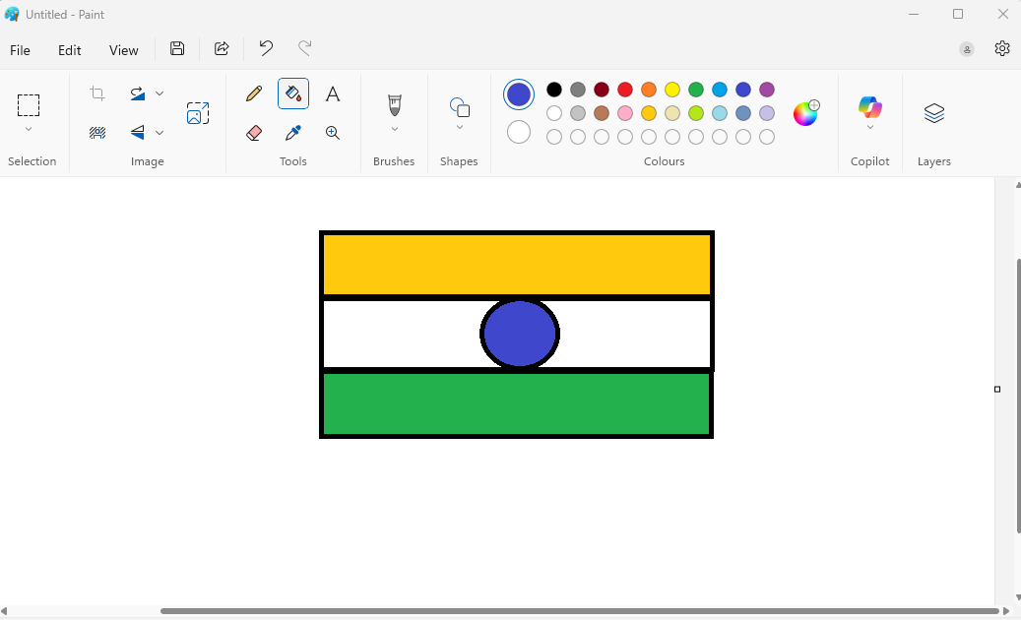
Draw the Indian Flag
Select the Rectangle tool. Draw three rectangles of similar size like this.

Slide 21
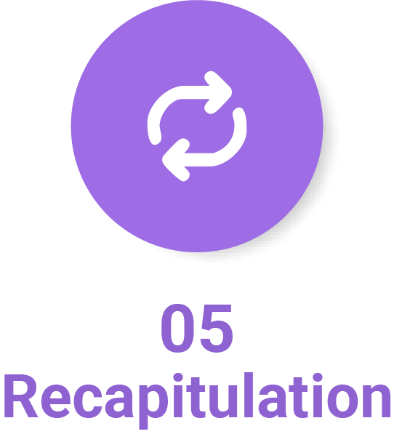

Slide 22
Which tool is used to draw the three parts of the flag?
A. Rectangle tool
B. Line tool
What is drawn in the center of the Indian flag?
A. A triangle
B. A circle (Ashok Chakra)
Which tool is used to fill colors in the flag?
A. Fill tool
B. Eraser tool
What should you do after completing your drawing?
A. Save the file
B. Delete the drawing
What is the last step after saving your work?
A. Print the flag
B. Shut down the computer

Slide 23
1. | A) | Rectangle tool
2. | B) | A circle (Ashok Chakra)
3. | A) | Fill tool
4. | A) | Save the file
5. | B) | Shut down the computer

